Slide 1
ANIMAL RIGHTS & WELFARE IN ISLAM
Prof Dr. Javaid Aziz Awan
Country Director
Ifanca Pakistan
www.ifancahalal.pk
ifancapk@gmail.com

Slide 2
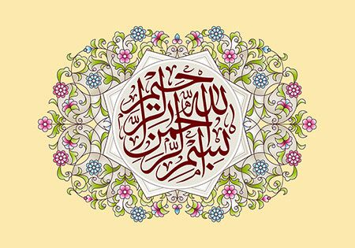

Slide 3
ABOUT IFANCA

Slide 4
Credentials
Dr. Muhammad Munir Chaudry
President, Islamic Food and Nutrition Council of America, Chicago
B.Sc., M.Sc. Univ. of Agriculture, Faisalabad
M.Sc. American Univ. of Beirut, Lebanon
Ph.D. Univ. of Illinois, Champaign-Urbana
Worked 20+ years in ingredient industry
Last 35+ years in halal certification

Slide 5
Credentials
Dr. Javaid Aziz Awan
Country Director
Islamic Food and Nutrition Council of America
Ifanca Pakistan Halal Apex Pvt Ltd
B.Sc., M.Sc. Univ. of Agriculture, Faisalabad
D.Sc. Univ. of Belgrade, Serbia (Yugoslavia)
Over 40 years teaching and research experience
80+ publications – National and international journals
9 books, 3 laboratory manuals, 6 chapters in national and international books
Pioneer in publishing research articles on Food and Nutrition in Islam

Slide 6
What is IFANCA? Islamic Food and Nutrition Council of America
Established in 1982
Owned, managed and operated by Muslims
Not for Profit Technical Islamic Organization
Supervising production of halal foods
Certifying halal products
Finding solutions for new challenges
Consulting with Islamic scholars on issues facing Muslims in selecting food products
Publishing relevant information
Notes:
6

Slide 7
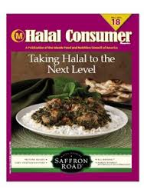
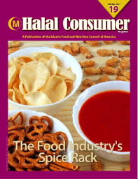

Slide 8
IFANCA Crescent M Certification
IFANCA’s activities spread in over 75 countries
IFANCA certified companies - over 2,200
IFANCA certified plants - over 5,000
IFANCA certified sites - over 3,200
IFANCA certified retail products – over 20,000
IFANCA certified industry products – over 100,000
Notes:
8

Slide 9
Crescent M Certification
IFANCA certificates and certified products accepted world over
IFANCA - recognized by organizations like
JAKIM Malaysia
MUI Indonesia
MUIS Singapore
MWL Saudi Arabia
United Arab Emirates
Notes:
9

Slide 10
Crescent M Certification
Global Affiliations:
IFANCA provides Halal certification in over 75 countries directly or through affiliates like:
HFCE, Europe
AFIC, Australia
NZIMM, New Zealand
IFNCC - Canada
Notes:
10

Slide 11
Halal Certification Logos
Notes:
11

Slide 12
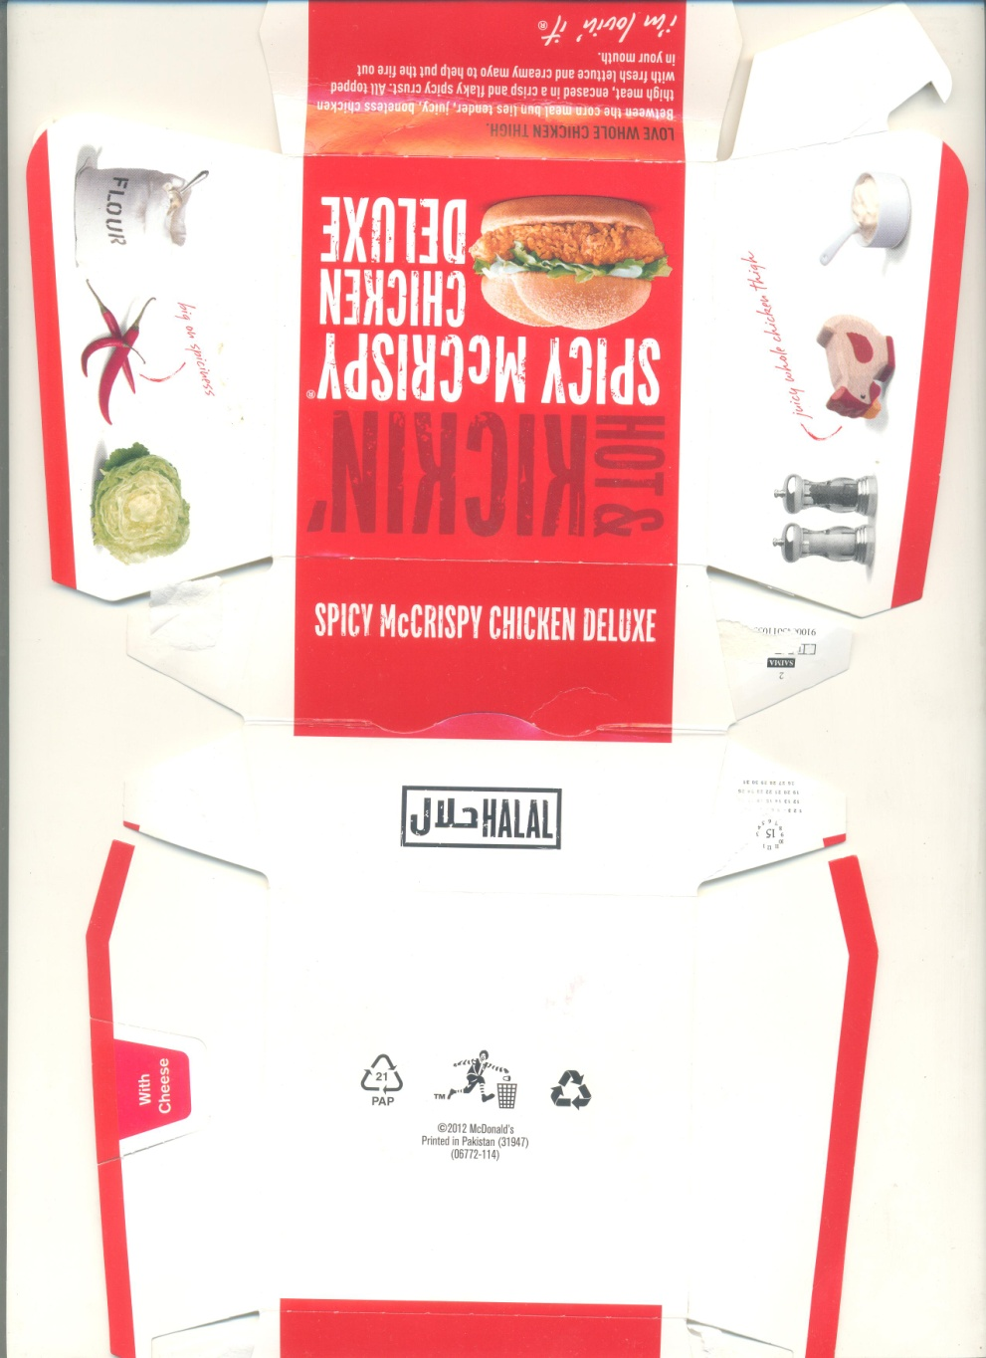

Slide 14
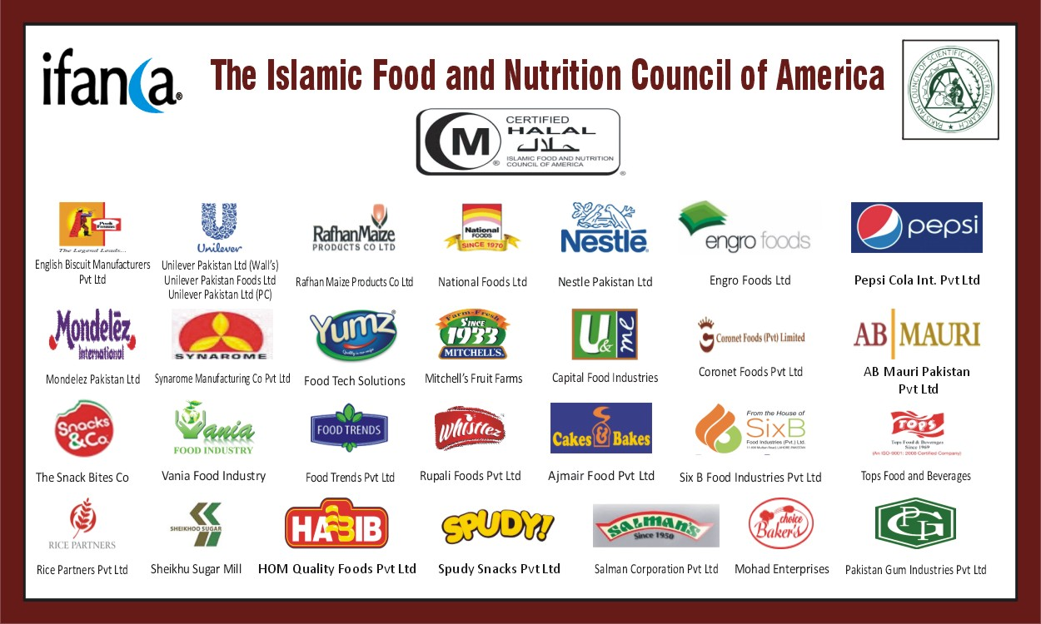

Slide 15
Some international Ifanca clients
9/12/2020
15

Slide 16
IFAN I IS STRIVING TO PROVIDE THE CONSUMER HALAL AND TAYYAB FOODS

Slide 17
HALAL, HARAAM AND MASHBOOH

Slide 18
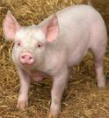
Halal
Halal - an Arabic word, means "lawful" or "permitted“
Opposite of halal - haraam - means "unlawful" or "prohibited“
For the mankind, particularly Muslims - all pure and clean things considered halal except:
Swine/pork and its products
Halal animals improperly slaughtered or dead before slaughtering

Slide 19
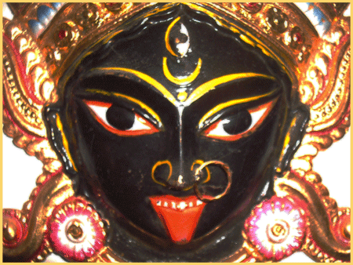
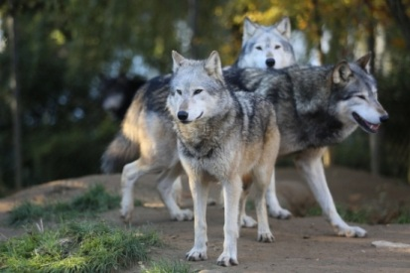
Haraam
Animals killed in the name of anyone other than ALLAH (God)
Blood and blood products
Carnivorous animals
Birds of prey
Intoxicants
Foods contaminated with any of the above products

Slide 20
Mashbooh
Numerou things clearly halal
Others clearly haraam
Some not clear – These considered questionable or suspect
More information needed to categorize them as halal or haraam
Such items often referred to as mashbooh
Foods containing ingredients such as gelatin, enzymes, emulsifiers, etc. are mashbooh - the origin of these ingredients must be known.

Slide 21
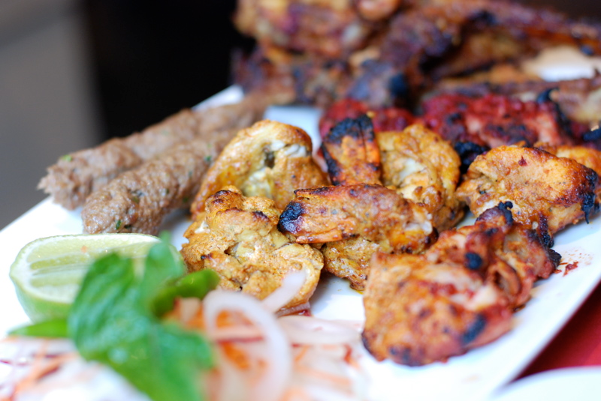
Tayyab
Arabic word ‘tayyab’ literally means something:
Beautiful
Tasty
Pure
Sweet
Magnificent
Free from any defects
Harmless in character

Slide 22
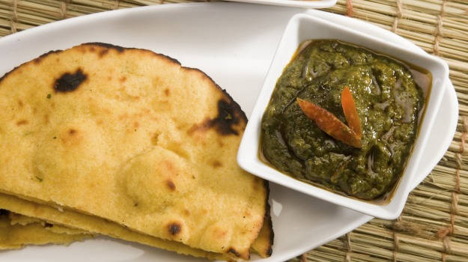
Tayyab
“Tayyab” food:
Attractive to look at
Palatable in taste
Nourishing for body
Acceptable to consumer
Causes no health-hazard to man
Islam permits consumption of safe and wholesome food

Slide 23
ANIMAL RIGHTS & WELFARE IN ISLAM
Prof Dr. Javaid Aziz Awan
Country Director
Ifanca Pakistan
www.ifancahalal.pk
ifancapk@gmail.com

Slide 24
INTRODUCTION
Animal rights refer to the entitlements of animals to the possession of their own lives and their most basic interests including need to avoid suffering.
On the other hand, the term "welfare" designates the state of an individual in relation to its surroundings (environment), which is measurable.
Animal welfare, thus, denotes the state of the animal and the treatment it receives during whole life span.
This includes animal care, animal husbandry and humane handling.

Slide 25
INTRODUCTION
Failure to manage with the environment and difficulty in coping are indicators of poor welfare.
Suffering and poor welfare often occur together, but welfare can be poor without suffering.
The indicators of poor animal welfare include impaired growth, impaired reproduction, body damage, disease, immune-suppression, adrenal activity, behaviour anomalies, etc.

Slide 26
Animal welfare
Globally, animal welfare is a matter of concern and is receiving more attention from the legislative authorities, the public and non-governmental organizations (NGOs).
The reasons advocated for this trend are that the animals are living beings and deserve kindness.
Secondly, in commerce, the maltreated animals yield lower quality meat than the ones well-kept and well handled.
Hence, improvements in animal welfare as well as animal handling systems are gaining consideration, especially for the meat animals to produce quality meat and meat products.

Slide 27
Animal welfare
Additionally, technological developments and mechanization have led to develop animal friendly systems that handle animals to ensure consideration for their welfare.
Improvement of animal welfare also leads to higher quality products and reduced waste, thereby increasing profits.
Therefore, good animal welfare is excellent business and the development and implementation of technology is the way to obtain improved animal welfare (Støier et al., 2016).

Slide 28
Animal welfare
In European Union (EU), welfare of animals raised for food purposes is the subject of ever on-going debate.
The governments are focusing on this by calling reduction of such techniques that are painful for the animals.
These include tail docking, castration, transport conditions, etc.
However, the legislation in developed countries demand increased emphasis on animal welfare.
Additionally, the market has established requirements for better food quality including demand for healthy meat leading towards efficient production systems and technologies.
These are geared to improve animal welfare, product quality and efficiency as well as working conditions for development of meat industry (Thornton 2010).

Slide 29
Legislations on Animal Welfare
Besides EU, regulations are also set by different organizations that demand animal welfare during production, transportation and at slaughtering.
However, Council Regulation No. 1099/2009 significantly focuses on animals handling on slaughtering day.
Additionally, EU legislations also require that slaughterhouses must appoint an animal welfare officer, establish standard operating procedures and entrust animals’ handling to properly trained personnel only.

Slide 30
Legislations on Animal Welfare
Moreover, operators need a certificate of competence that clearly reflects their ability to handle the animal to avoid stress in them.
Globally, OIE (World Organization for Animal Health, formerly called Office International des Epizooties) has greatly contributed to increased awareness of animal welfare for meat animals.
It is also trying to establish international standards for better handling of animals.

Slide 31
Islam and Animal Welfare
Islam is the religion of compassion and affection.
One of its objectives is to create and provide ease.
The word “Islam” has been derived from peace and harmony.
Prophet Muhammad (ﷺ) preached brotherhood, compassion, mercy, mutual cooperation and trustworthiness all of his life.
He (ﷺ) started from himself and exhibited a model to His followers.
Nevertheless, He (ﷺ) revealed a complete code of welfare for animals as well.
They were treated in the manners even mankind was not behaved alike in other parts of the world in His sacred era.
This presentation intends to explore the various aspects of animal welfare highlighted by Islam in contrast with the modern day’s industrial practices and regulations.

Slide 32
ISLAM AND ANIMAL WELFARE
All living creatures including humans, animals, birds and insects are worthy for consideration and deserve respect since Islam views them as Allah’s creations.
Islam strongly enforces its followers to treat animals with compassion and do not abuse them.
The Holy Qur'an, Ahadith as well as Islamic civilization history have witnessed numerous examples of kindness, mercy and sympathy for animals.
According to Islamic teachings, animals have specific position and purpose in the creation hierarchy.
Fundamentally they have been created to fulfil the multiple needs of the mankind.
On the other hand, humans have been directed not to waste the lives of animals and are held responsible for their well-being and feed.

Slide 33
ISLAM AND ANIMAL WELFARE
The Prophet (ﷺ) warned, "there is no person who kills a small bird or anything larger for just nothing, but Allah, the Mighty and Sublime, will ask him about it”.
When the Messenger of Allah was asked about “nothing”, He (ﷺ) replied: "that you slaughter the animal and eat it and do not cut off its head and throw it aside” (Sunan an-Nasa'i, 4349).
In simple terms, one is only permitted to kill an animal for particular need, e.g. food.

Slide 34
ISLAM AND ANIMAL WELFARE
Apart from the daily usual and common benefits, Islam has disclosed some outstanding characters bestowed upon the animals which can be even useful in the present scientific era.
The Prophet (ﷺ) revealingly said: When you hear the barking of dogs and the braying of asses at night, seek refuge in Allah, for they see which you do not see (Sunan Abi Dawud 5103).
According to this revelation some animals have the capability to foresee the natural events such as flood, earthquake or hurricane that cause great damage or loss of life.
Hence, they need more attention from the mankind in contrast to what humans normally offer.

Slide 35
The Holy Quran and Animals
The Almighty Allah, the Creator of this Universe, assigned space to all its creations:
"And the earth, He has assigned it to all living creatures" (LV:10).
This reflects that the earth is not only meant to be used by the human race, but for all the living beings – be these insects, rodents, animals, birds or the water creatures.
The significance of animals in Islam is evident from the fact that out of 114 Suras (Chapters) in the Holy Quran, six have been named after them.
Among these are Al-Baqarah (The Cow, II), Al-An’am (The Flocks, VI), An-Nahl (The Bee, XVI), An-Naml (The Ant, XXVII), Al-Ankabut (The Spider, XXIX) and Al-Fil (The Elephant, CV). Besides these, there are numerous verses in different Chapters that deal with the animals.

Slide 36
The Holy Quran and Animals
These citations in the Holy Quran reflect the fact that along with human beings, animals are also noteworthy in Islam and have their rights.
No doubt, superiority rests in the children of Adam, yet these creatures have a significant role to play in this universe.
The above-mentioned Chapters, in addition to Surah Al-Maidha (V), narrate their benefits for mankind.
Some animals are domesticated as livestock, hence provide milk, meat and leather, while others are used for transportation (XL-79-80).
“Allah it is Who hath appointed for you cattle, that ye may ride on some of them, and eat of some - Many benefits ye have from them - and that ye may satisfy by their means a need that is in your breasts, and may be borne upon them as upon the ship.” (XL:79-80).

Slide 37
The Holy Quran and Animals
Every living organism in this universe has worth and is part of the human society.
Therefore, Muslims are required to treat them with compassion and not to abuse them.
Islam has laid down rights for animals long before even the human rights were recognized in the Western world.
In Islam, all the creations, including animals, are believed to praise the Almighty Allah since, like humans, they are creations of Allah.
Prophet Muhammad (ﷺ) was sent as a mercy to mankind and a blessing for all creatures, as reflected in the following verse:
“And We have not sent you but as a mercy for the worlds.” (XXI:107)

Slide 38
The Holy Quran and Animals
The Holy Quran further defines animals as well as all living beings, as submissive, since they live the way that Almighty Allah has created them to live, and they follow Allah's laws:
"There is not an animal that lives on neither the earth, nor a being that flies on its wings, but they form communities like you. Nothing have we omitted from the Book, and they all shall be gathered to their Lord in the end" (VI: 38)
“Have you not seen that to Allah extol, whoever are in the heavens and the earth and the birds outstretching (their wings)? (Or: in ranks) Each has already known its prayer and Extolment; and Allah is Ever-Knowing of whatever they perform”. (XXIV:41)
These verses serve as reminder to all of us that none of the animals are created without purpose and that they have feelings.
Therefore, they have the right to their lives, as well as protection from pain and suffering.
Man must consider their lives as worthwhile and cherished.

Slide 39
Using animals as shooting targets
There are numerous Ahadith that dwell on humane handling of animals.
The Prophet Muhammad (ﷺ) urged Muslims to express kindness towards animals and birds, and repeatedly prohibited cruelty towards them.
This is reflected in some Ahadith
Before the arrival of the Holy Prophet (ﷺ), animals were cruelly confined and tied as shooting targets.
The people at that time used to enjoy this practice.
This was banned by the Messenger of Allah (ﷺ) who prohibited taking a living thing as a shooting target (Jami`at-Tirmidhi 1475).

Slide 40
Using animals as shooting targets
Hazrat Muhammad (ﷺ) was sent on the earth as compassion and mercy, not only for mankind but also for the animals (XXI: 107).
In this regard He (ﷺ) forbade the people from harming or torturing the animals.
On different occasions He (ﷺ) prohibited the people from dragging, mutilating and branding the animals or making them fight each other.
Moreover, He (ﷺ) barred people from caging the birds as He (ﷺ) declared it a painful act.
He (ﷺ) also prohibited the followers from killing non-hazardous tiny creatures like ants, bees, frogs, etc.
These aspects of kindness towards the animals are reflected in several hadiths:-

Slide 41
Maltreating animals
The Holy Prophet (ﷺ) passed by a man who was dragging a sheep by its ear, He (ﷺ) said: ‘Leave its ear and hold it by the sides of its neck.’ (Sunan Ibn Majha 3291). Pulling an animal by the ears is more painful than pulling it by the neck.
The Holy Prophet (ﷺ) forbade beating (animals) on the face. (Sahih al-Bukhari 5541). Face is more sensitive than other parts, hence it is painful to the animal to hit on the face.
It is reported that He (ﷺ) disliked making animals fight each other. (Al-Adab-ul-Mufrad 1232). When animals fight, they hit each other with full strength that causes pain to both the fighting animals.
The Messenger of Allah (ﷺ) forbade mutilating animals. (Sunan Ibn-e-Majah 3306).
Mutilating is an act that is disliked even today. It is painful when using hot iron or other such techniques.

Slide 42
Maltreating animals
A man said to the Holy Prophet that he was going to slaughter a sheep and then felt sorry for the sheep.
The Holy Prophet (ﷺ) said twice, 'Since you showed mercy to the sheep, Allah will show mercy to you”. (Al-Adab Al-Mufrad 373).
Abd al-Rahman b. ‘Abd Allah quoted his father as saying: When we were on a journey with the Messenger of Allah (ﷺ) and He (ﷺ) had gone to relieve himself, we saw a small bird its two chicks.
We took the young ones.
The mother came and began to spread out its wings.
The Holy Prophet (ﷺ) came and asked: who teased this bird?
Give the young ones back to her.
We also saw an ant-hill which we had burned.
He asked: who has burnt this?
We replied: we have.
He said: it is not befitting that anyone but the Lord of the fire should punish with fire (Sunan Abi Dawud 5268).

Slide 43
Maltreating animals
Narrated Abdur Rahman ibn Uthman: When a physician consulted the Prophet (ﷺ) about putting frogs in medicine, he forbade him to kill them (Sunan Abi Dawud 5269)
Narrated Abdullah ibn Abbas: The Prophet (ﷺ) prohibited to kill four creatures: ants, bees, hoopoes and sparrow-hawks (Sunan Abi Dawud 5267).

Slide 44
Modern requirements
In line with the above revelations the modern halal industrial practices/standards also emphasize that the animals/birds should be treated humanely.
They should be treated in ways that minimize fear, pain, stress and suffering.
They should be provided with water, food, proper handling, health care, and an environment appropriate to their care and use, with thoughtful consideration for their species-typical biology and behaviour.
Moreover, they should be provided with water and feed during long journeys.
If animals/birds have arrived from long distance, they should first be allowed to rest and be provided with water and feed (PS: 3733-2016).

Slide 45
Modern requirements
With the support and close co-operation of the Member States, the European Commission has been promoting animal welfare for over 40 years gradually improving the lives of farm animals.
An important step in 1998 was Council Directive 98/58/EC on the protection of animals kept for farming purposes which gave general rules for the protection of animals of all species kept for the production of food, wool, skin or fur or for other farming purposes, including fish, reptiles or amphibians (EC 2009).
They reflect the so-called 'Five Freedoms':
Freedom from hunger and thirst
Freedom from discomfort
Freedom from pain, injury and disease
Freedom to express normal behaviour
Freedom from fear and distress

Slide 46
REWARD AND PUNISHMENT FOR TREATMENT OF ANIMALS
Islam has surprised the world by qualifying a person to haven for being kind to animals and to hell for ill treatment.
In the ages of darkness, when even mankind could not be imagined to be treated well, animals were put in the slant of compassion and kindness.
Following hadiths are eye openers to the mercy of this religion in this context.
On one occasion, the Holy Prophet (ﷺ) narrated a story that a man felt very thirsty while he was travelling. He came across a well, went down and quenched his thirst. When he came out, he saw a dog panting and licking mud because of excessive thirst. He said to himself that this dog is suffering from the same thirst as I did. So, he went down the well again and filled his shoe with water and watered the dog. Allah rewarded him for that deed and forgave his sins. The people asked, "O Allah's Messenger (ﷺ)! Is there a reward for us in serving the animals?" He (ﷺ) replied: "Yes, there is a reward for serving any animate (living being)." (Sahih Bukhari 551).
It is reported that the Messenger of Allah (ﷺ) said that a woman punished her cat by imprisoning it until it died of hunger. Because of this, she entered the Fire (was sent to hell). (Al-Adab Al-Mufrad 379).

Slide 47
KINDNESS TO ANIMALS DURING SLAUGHTER
Islam permits consumption of meat of halal animals only.
None of the halal animals can be consumed without proper slaughtering as directed by Muhammad (ﷺ).
Even for these animals, the Holy Prophet (ﷺ) has directed His followers to “show mercy, that will be rewarded by Allah on the Day of Rising." (Al-Adab Al-Mufrad 381).
He (ﷺ) emphasized on the manners and etiquettes of slaughtering, in addition to the basic principles to safeguard the animals from unnecessary pain.
Following ahadith proclaim the protocols of slaughter:

Slide 48
KINDNESS TO ANIMALS DURING SLAUGHTER
The Holy Prophet (ﷺ) said that Allah has decreed that everything should be done in a good way, so when you kill an animal, use a good method.
The version of the narrators, other than Muslim, says: "So kill in a good manner."
And when you slaughter, sharpen your knife, and give the animal as little pain as possible. (Sunan Abu Dawud 2815).
In another hadith, Prophet Muhammad (ﷺ) said that verily Allah has enjoined goodness to everything; so when you kill, kill in a good manner and when you slaughter, slaughter in a good manner.
He (ﷺ) further said that everyone must sharpen his knife, and let the slaughtered animal die comfortably. (Sahih Muslim 1955)

Slide 49
KINDNESS TO ANIMALS DURING SLAUGHTER
It is narrated (Sunan Abu Dawud 2826) that the Messenger of Allah (ﷺ) forbade the devil's sacrifice (cruel killing).
This refers to the skinning of slaughtered animal whose jugular arteries and veins are not properly severed and the animal dies without proper bleeding.

Slide 50
Islam on animal rights
Fourteen hundred years ago Prophet Muhammad (ﷺ) directed that animals must be treated humanely particularly when they are being slaughtered.
Today merciful treatment with animals has become talk of the town.
Specific pre- and post-slaughter guidelines have been introduced for the abattoirs.
Currently the animals are being slaughtered under the guidance of both religious and conventional (non-halal) standards.
But both the types are conscious regarding the compassionate treatment during slaughter.
The conventional standards advocate that animals must be stunned before slaughter.
It is a standard industrial practice worldwide, since this makes them unconscious and easy to handle.
The knife should be very sharp, without blemishes or damage and be at least double the width of the neck.
It should be used in a fast, aggressive cut across the throat with the least number of strokes in order to bring about immediate and massive blood loss (Needham, 2012).

Slide 51
Islam on animal rights
Whereas gist of the halal standards in this regard reflects that animals must be served with mercy, hence, they must be treated such that they are not stressed or excited prior to slaughter.
Holding areas for anials should be provided with drinking water, as well as they should be nourished and well rested.
The slaughter knife must be sharp.
The size of the knife (blade length) should be proportioned to the size of the neck.
The knife should not be sharpened in front of the animal.
Furthermore, one animal should not be slaughtered in front of another animal (Awan et al., 2017).

Slide 52
CUTTING A PART FROM LIVE ANIMAL
Cutting a part from a live animal was a cruel practice among the Arabs.
They used such organs for consumption.
More often the injured animal died due to bleeding and pain.
The Holy Prophet (ﷺ) strictly banned this ill treatment, as evident from the following ahadith:
The people of Madinah were in the habit of cutting the humps off the camels and cutting the hindquarters from the sheep.

Slide 53
CUTTING A PART FROM LIVE ANIMAL
When the Prophet (ﷺ) came to Al-Madinah and saw this practice, he said: 'whatever is cut from an animal while it is still alive, then it is dead flesh’ (and dead is haraam in Islam). (Jami at-Tirmidhi 1480).
The Prophet (ﷺ) cursed the person who did Muthla to an animal (i e., cut its limbs or some other part of the body while it is still alive). (Sahih al-Bukhari 5515).
These two ahadith reflect the height of kindness towards the animals.
Islam not only advocates that live animals be treated with mercy, but the partly dead (that has not bled completely and still shows signs of life) must also be taken care of.
It is prohibited to start skinning or cutting parts of the animal after slaughtering until it is completely dead.
The act of torturing animals after slaughtering is prohibited by decreeing that the meat of such animals becomes haraam.

Slide 54
SLAUGHTERING LACTATING ANIMALS
Lactation implies the secretion of milk from the mammary glands and the time duration that a mother lactates to feed her young one.
This period is considered important for the better growth and nourishment of the new born.
In Islam slaughtering or killing of lactating animals is disliked as is evident from the following hadith:
Once Hazrat Muhammad (ﷺ) came nearer a man from among the Ansar who had picked up a knife to slaughter an animal for the Messenger of Allah (ﷺ), the Holy Prophet (ﷺ) said to him: “Avoid those animals that are lactating.” (Sunan Ibn e Majha 3180).

Slide 55
CONCLUSIONS
From the above discourse, it can be judged that Islam is the religion of peace and compassion.
It not only takes care of the mankind but the animals also.
Before Islam, there was darkness everywhere.
Animals were treated very cruelly.
They were tied as shooting targets
They were made to fight each other for the fun and pleasure of the people.

Slide 56
CONCLUSIONS
Their body parts were cut for consumption even when they were alive.
They were used in long journeys without proper feed.
The people at that time did not hesitate while slaughtering the lactating animals.
All these barbaric acts resulted in the miserable death of the animals.
There was no compassion and mercy for them.
Prophet Muhammad (ﷺ) decreed that they shall be treated in good manners.
As they are part and parcel of the human society, hence they shall be treated humanely in all aspects of their lives.

